Slide 1
CPU control unit design

Slide 2
Control unit
The Control Unit is the part of the computer’s central processing unit (CPU), which directs the operation of the processor.
Control unit generates timing and control signals for the operations of the computer. The control unit communicates with ALU and main memory. It also controls the transmission between processor, memory and the various peripherals. It also instructs the ALU which operation has to be performed on data.

Slide 3
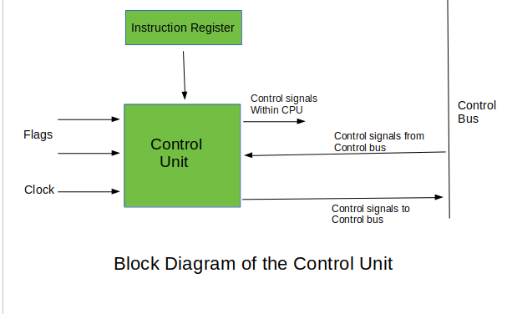

Slide 4
Functions of the Control Unit
It coordinates the sequence of data movements into, out of, and between a processor’s many sub-units.
It interprets instructions.
It controls data flow inside the processor.
It receives external instructions or commands to which it converts to sequence of control signals.
It controls many execution units(i.e. ALU, data buffers and registers) contained within a CPU.
It also handles multiple tasks, such as fetching, decoding, execution handling and storing results.
The Control Unit is classified into two major categories:
Hardwired Control
Micro programmed Control

Slide 5
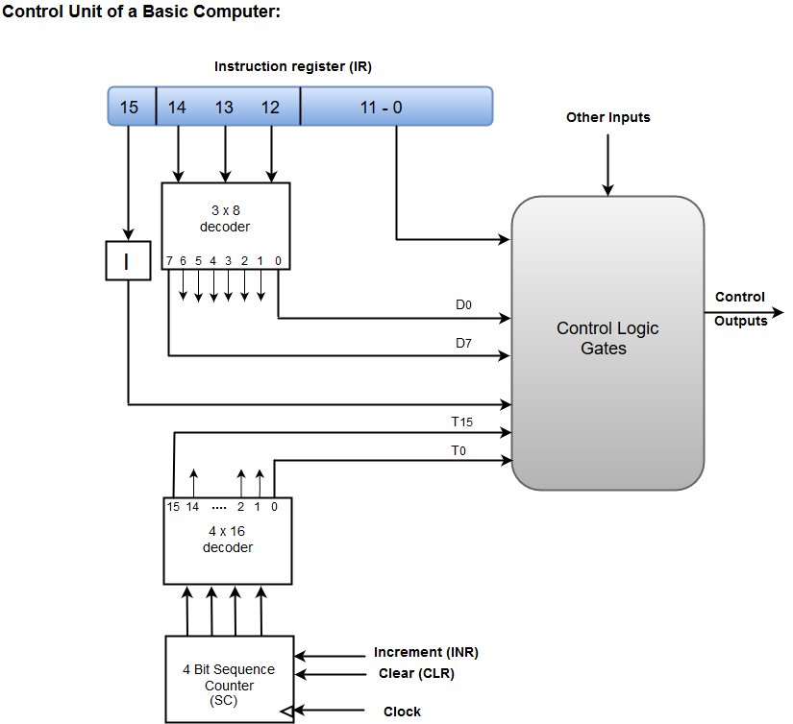
Hardwired Control unit
The Hardwired Control organization involves the control logic to be implemented with gates, flip-flops, decoders, and other digital circuits.

Slide 6
A Hard-wired Control consists of two decoders, a sequence counter, and a number of logic gates.
An instruction fetched from the memory unit is placed in the instruction register (IR).
The component of an instruction register includes; I bit, the operation code, and bits 0 through 11.
The operation code in bits 12 through 14 are coded with a 3 x 8 decoder.
The outputs of the decoder are designated by the symbols D0 through D7.
The operation code at bit 15 is transferred to a flip-flop designated by the symbol I.
The operation codes from Bits 0 through 11 are applied to the control logic gates.
The Sequence counter (SC) can count in binary from 0 through 15.

Slide 7
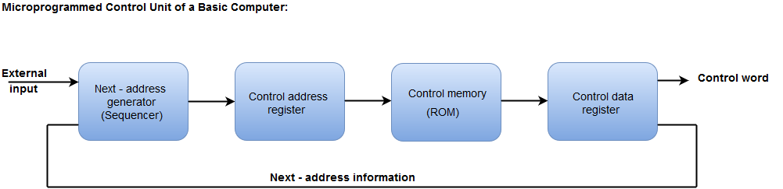
Micro programmed Control unit
The Micro programmed Control organization is implemented by using the programming approach.
In Micro programmed Control, the micro-operations are performed by executing a program consisting of micro-instructions.

Slide 8
The Micro programmed Control organization is implemented by using the programming approach.
In Micro programmed Control, the micro-operations are performed by executing a program consisting of micro-instructions.
The Control memory address register specifies the address of the micro-instruction.
The Control memory is assumed to be a ROM, within which all control information is permanently stored.
The control register holds the microinstruction fetched from the memory.
The micro-instruction contains a control word that specifies one or more micro-operations for the data processor.
While the micro-operations are being executed, the next address is computed in the next address generator circuit and then transferred into the control address register to read the next microinstruction.
The next address generator is often referred to as a micro-program sequencer, as it determines the address sequence that is read from control memory.

Slide 9
Difference between Hardwired Control and Micro programmed Control
Hardwired Control | Microprogrammed Control
Technology is circuit based. | Technology is software based.
It is implemented through flip-flops, gates, decoders etc. | Microinstructions generate signals to control the execution of instructions.
Fixed instruction format. | Variable instruction format (16-64 bits per instruction).
Instructions are register based. | Instructions are not register based.
ROM is not used. | ROM is used.
It is used in RISC. | It is used in CISC.
Faster decoding. | Slower decoding.
Difficult to modify. | Easily modified.
Chip area is less. | Chip area is large.

Slide 10
Design of a simple Hypothetical CPU
A computer has three main components 1) Central Processing Unit (CPU) or Central Processor 2) Memory 3) I/O Devices The CPU in turn has three parts 1) Arithmetic and Logic Unit (ALU) 2) Registers 3) Control Unit (CU)
Arithmetic and Logic Unit (ALU) The ALU performs the following operations: Addition, Subtraction, Logical AND, Logical OR, Logical XOR, Complement, Increment, Decrement, Left Shift, Clear.
Registers This is a small memory unit. Registers are used by the processor for temporary storage and manipulation of data and instructions. A register is a set of flip-flop. A flip-flop is an electronic circuit, which at any point of time stores either 0 or 1, which is any of the two states of a switch ON or OFF. A register is mostly of different sizes and capacities : 8 bit, 16 bit, 32 bit, etc. Each register has a specific function in the CPU.

Slide 11
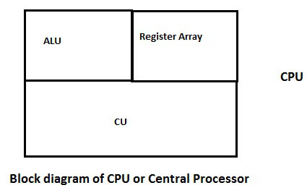
Given below are few commonly known registers: Accumulator (AC) the ALU requires temporary registers or memory locations for all its operations. An accumulator is one of the main registers of the ALU, used to store data and perform arithmetic and logic operations. The results of the operations are stores automatically in this register. Program Counter (PC) A PC is used as a memory pointer. It stores the address of the next instruction to be executed. this register is used to sequence the execution of instructions. Instruction Register(IR) An IR holds the instruction until it is decoded. Stack Pointer(SP) the address of a stack top is held in the stack pointer. A stack is a sequence of memory locations. It is used to save the contents of a register during the execution of a program. the memory location of an occupied potion is known as stack top.

Slide 12
Given below are some of the registers for a basic computer and their functions: Symbol Name Function DR Data Register Holds memory operand AR Address Register Holds address for memory AC Accumulator Processor Register IR Instruction Register Holds instruction code PC Program Counter Holds address of next instruction TR Temporary Register Holds Temporary data INPR Input Register Holds Input Character OUTPR Output Register Holds Output Character Control Unit (CU) This circuit is responsible for the entire amount of functions of the ALU. It receives instructions from memory and executes them after decoding them. Timing and control signals are generated by this circuit and sent to other circuits for the execution of the any program. It also transfers data between memory and I/O devices.

Slide 13
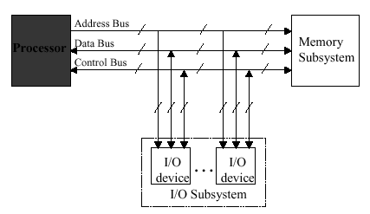
The Main purpose of Central Processing Unit
It control the system
It performs data movements
It have the data processing capability
It have the data storage functionality.
Generic Computer Organization

Slide 14
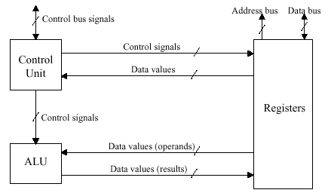
CPU Internal Organisation

Slide 15
The design of a hypothetical processor can consists of an ALU to operate on the Operands, accumulator used to store one of the operands to be processed by ALU and also store the partial result and a temporary register, register file containing four general purpose registers.
The processor can perform processing, Calculation and decisions.
The CPU should be capable of performing basic arithmetic and logical operations, as well as accessing and manipulating data in memory. The system should have a minimal Instruction Set Architecture(ISA) and be optimized for power efficiency.
S1 simple cpu
The design of a simple hypothetical CPU called S1. S1 contains all the important elements of a real processor

Slide 16
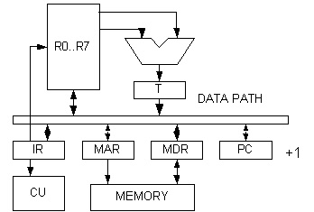

Slide 17
Instruction set design
16 bit word, fixed length
address space 1024 words
load, store architecture
8 registers, R7 as stack pointer
condition code Z,S zero,sign
Hypothetical system uses a simple Reduced Instruction Set computer(RISC).
ISA with the following instructions:
1.Load word(LW):load a 32 bit word from memory in to a register.
2.Store Word(SW):store a 32 bit word from register to memory.
3.ADD(add):Add two registers and store the result in a third register.
4.Subtract(sub):Subtract one register from another and store the result in a third register.
5.AND(and):perform a bitwise AND operation on two registers and store the result in a third register.

Slide 18
OR(or):Perform a bitwise OR operation two registers and store the result in a third register.
Jump(j):jump to a target address.
Data path: It is the part of the CPU that performs ALU operations.
Simple CPU use a 3 stages pipeline.
1.Instruction Fetch(IF)
2. Instruction Decode(ID)
3.Execute(EX)
Data path Components: Program counter(PC),Instruction Memory(IM),Register file,ALU,Data memory

